Slide 1


Slide 2
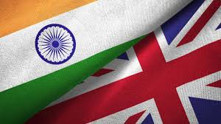
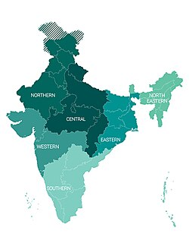
Intro
India has a unique culture and is one of the oldest and greatest civilizations of the world. As the 7th largest country in the world, India stands apart from the rest of Asia, marked off as it is by mountains and the sea, which give the country a distinct geographical entity. Bounded by the Great Himalayas in the north, it stretches southwards and at the Tropic of Cancer, tapers off into the Indian Ocean between the Bay of Bengal on the east and the Arabian Sea on the west.

Slide 3
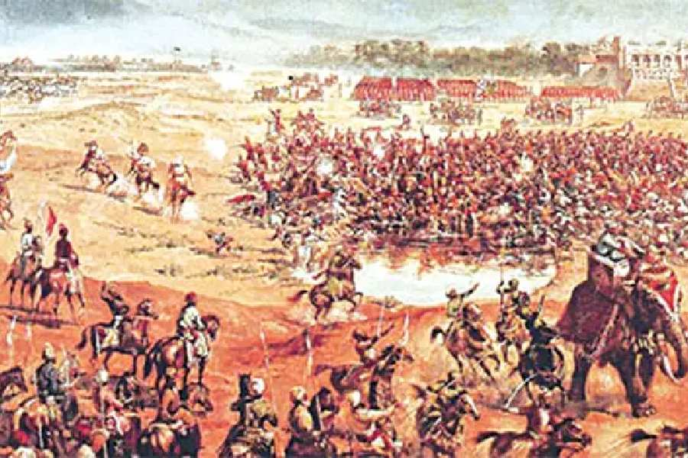
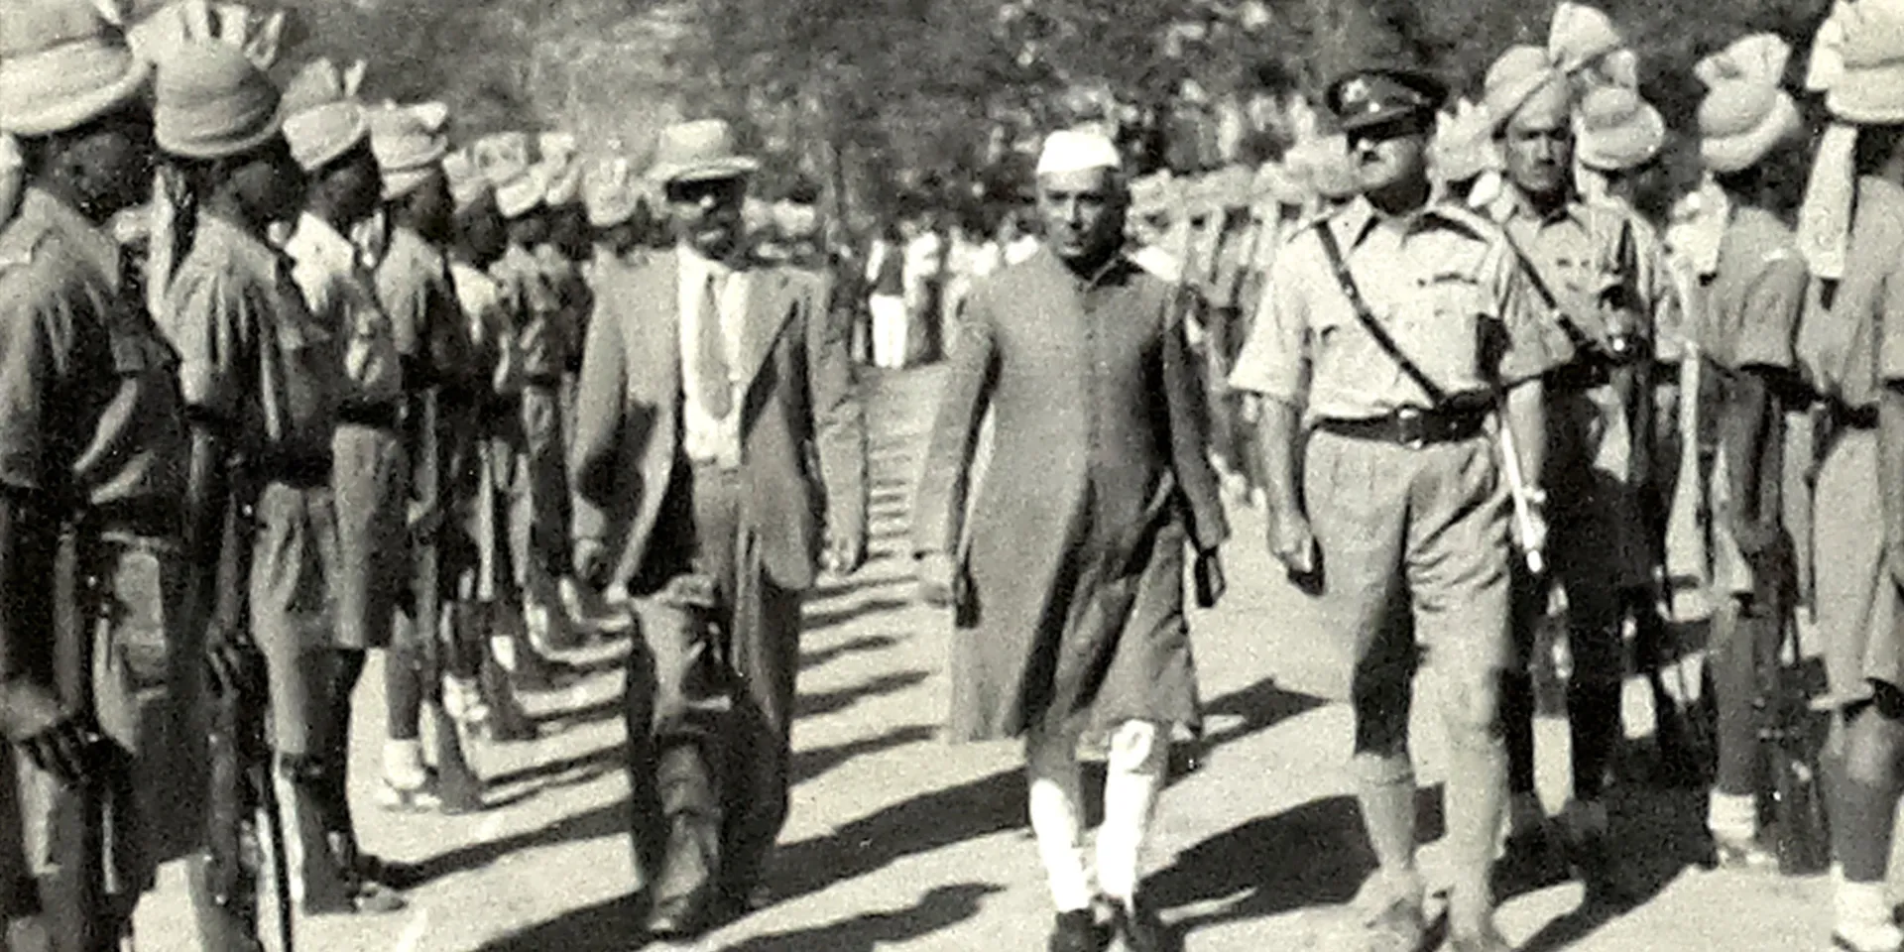
History
Battle of Plassey, 1757
Independence and partition, 1947

Slide 4

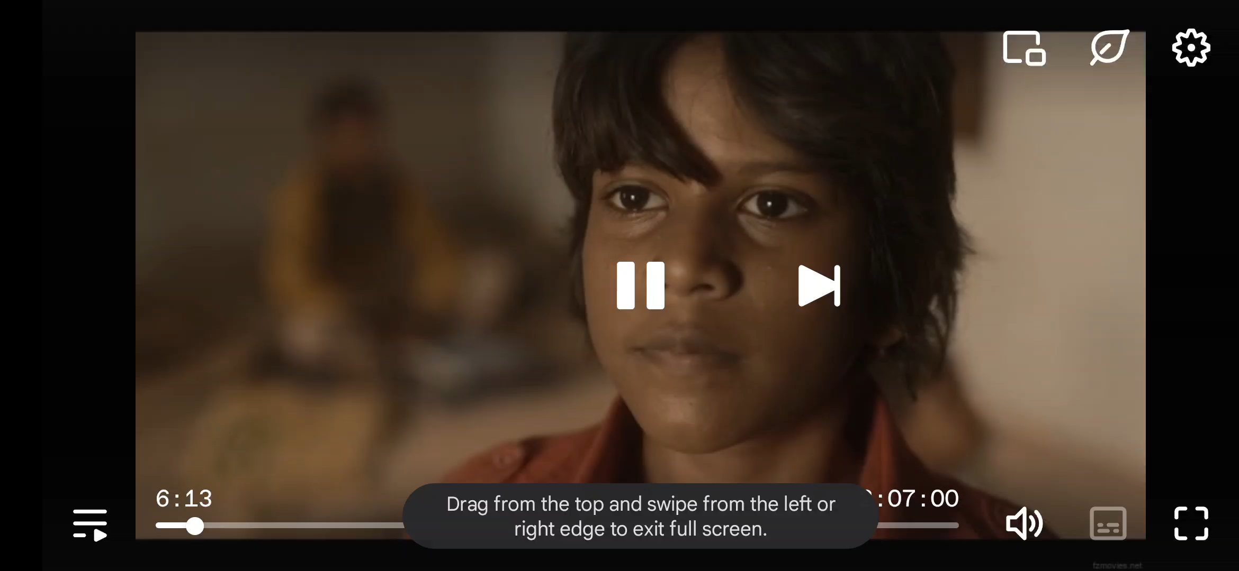
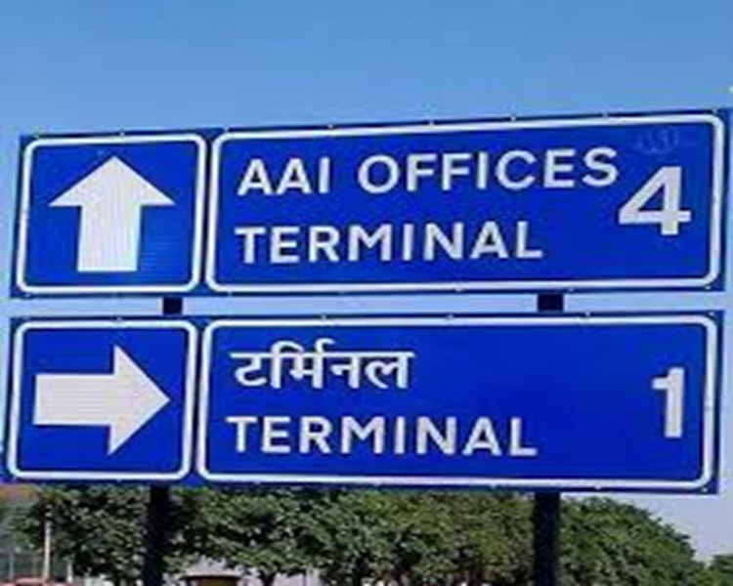
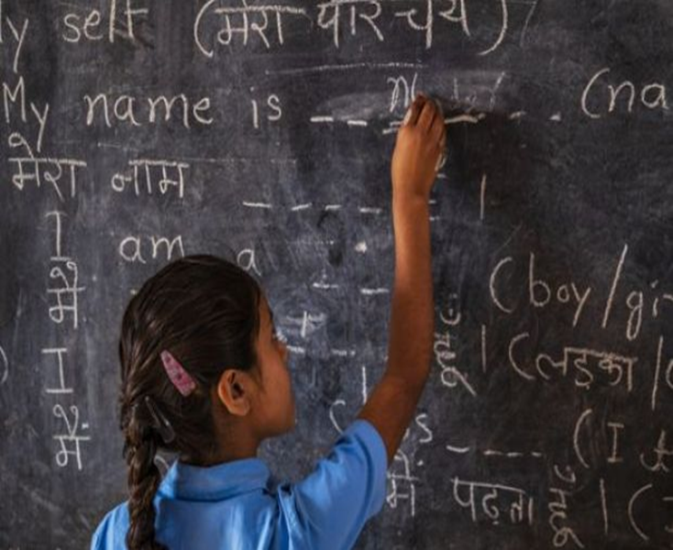
Proof

Slide 5
References:
Baber, Z. (1996). The science of empire: Scientific knowledge, civlization, technology and society. Albany, NY: State University of New York Press.
Lloyd, D. (2008). Ireland after history. In H. Schwarz & S. Ray (Eds.), A Companion to
Postcolonial Studies (pp. 377–395). Oxford, England: John Wiley & Sons.
Lyer, L. (2010). Direct versus indirect colonial rule in India: long-term consequences. The Review of Economics and Statistics, 92(4), 693–713.
Stokes, E. (1973). The First Century of British Colonial Rule in India: Social Revolution or Social Stagnation? Past & Present, 58, 136–160.
Byrne, S., Clarke, M. A., & Rahman, A. (2018). Colonialism and peace and conflict studies(Introduction Article in journal to be published). Peace and Conflict Studies, 25(1).

